Slide 1
CNA 361 AZURE PROJECT PRESENTATION
Thando Mnguni (601203)
Sicelo Tasha Mkhatshwa (602608)

Slide 2
AGENDA
Problem Statement
Solution Overview
Cloud Architecture
Infrastructure Deployment
Remote Access
Storage, Collaboration & Security
Testing & Optimization
Live Demonstration
Lessons Learned & Q&A

Slide 3
Problem Statement How can Belgium Campus IT Varsity use cloud technology to enable remote learning, improve collaboration, and reduce IT costs while keeping student data secure?
Belgium Campus IT Varsity faced several challenges:
Limited scalability
Difficulty supporting remote learning
Limited collaboration tools
Security and access control concerns
High maintenance costs

Slide 4
MILESTONE ONE
In Milestone 1, we analyzed the needs of students, lecturers, and administrators, then designed a cloud architecture using Microsoft Azure.
We created requirement analyses, user scenarios, selected appropriate cloud technologies (VNet, VMs, Storage, Entra ID), and developed a complete architecture diagram showing how all components would interact. This laid the foundation for the entire project.

Slide 5
MILESTONE 2
In Milestone 2, we built the actual cloud infrastructure in Azure. We deployed a Virtual Network with three subnets (Web, App, DB), created Network Security Groups to control traffic between tiers, launched Windows virtual machines, set up a storage account with blob containers, and configured Azure Bastion for secure remote access.
All resources were organized in a single resource group called BelgiumCampus-RG.

Slide 6
MILESTONE 3
In Milestone 3, we enabled students and lecturers to access computing resources remotely.
We configured Azure Bastion for secure RDP connections, created test users (Student and Lecturer) in Microsoft Entra ID, assigned them to security groups, and granted Virtual Machine User Login roles.
We successfully connected to the Windows desktop remotely and verified that applications run correctly.

Slide 7
MILESTONE 4
In Milestone 4, we focused on secure storage and collaboration.
We created blob containers for course materials and student submissions, set up a file share for group project collaboration, configured IAM roles (Storage Blob Data Reader for students, Contributor for lecturers, Owner for administrators), and enabled data protection features including blob versioning, soft delete, and encryption at rest.

Slide 8
MILESTONE 5
In Milestone 5, we tested all system components to verify they work correctly, used Azure Monitor to track performance metrics (CPU usage, storage transactions), documented optimization recommendations for performance, scalability, and cost efficiency, and prepared the final system documentation.
All tests passed, confirming the system is ready for production use.

Slide 9
Solution Overview We built a cloud solution on Microsoft Azure that students can access remotely to run applications and submit assignments. Lecturers can upload course materials and manage submissions, while file shares allow group collaboration with proper security controls in place.
Cloud provider: Microsoft Azure
Region: South Africa North
Hybrid cloud approach (on-premises + cloud)
Three-tier architecture (Web, App, Database)

Slide 10
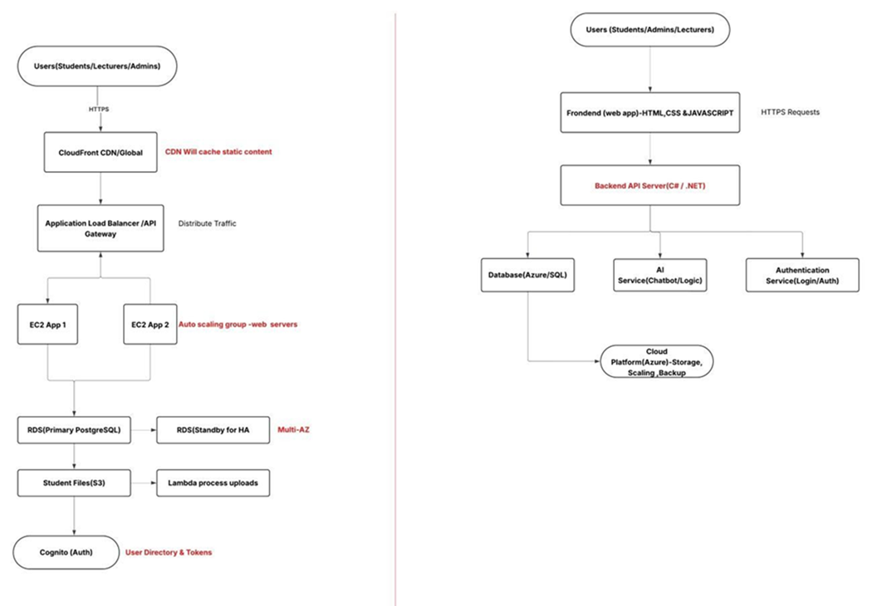
Architecture diagram

Slide 11
Cloud Architecture
Three-Tier Architecture:
[Users] → [Web Tier] → [App Tier] → [Data Tier]
(Frontend) (Logic) (Storage)
Tier | Components | Purpose
Web | Web-VM | Hosts web portal
App | App-VM | Processes business logic
Data | Storage Account, SQL | Stores academic files and records

Slide 12
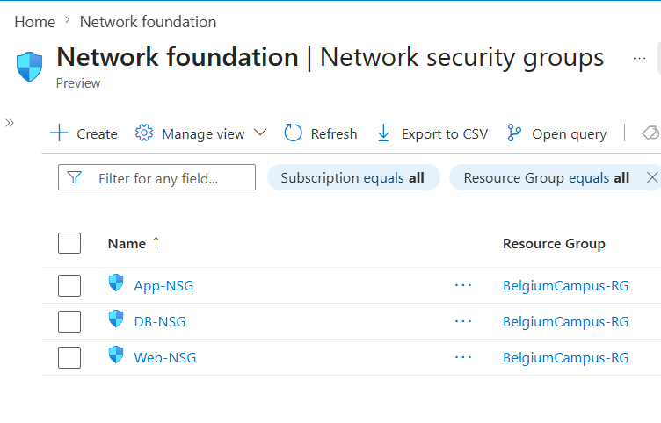
Network Configuration
Virtual Network: BelgiumCampus-Vnet 10.0.0.0/16
Three subnets:
Web-Subnet (10.0.1.0/24) - Frontend web servers
App-Subnet (10.0.2.0/24) - Backend application servers
DB-Subnet (10.0.3.0/24) - Database and storage
Network Security Groups control traffic between tiers
Network Security Groups (NSGs):
Web-NSG: Allows HTTP (80), RDP (3389)
App-NSG: Accepts traffic only from Web-Subnet
DB-NSG: Accepts traffic only from App-Subnet

Slide 13
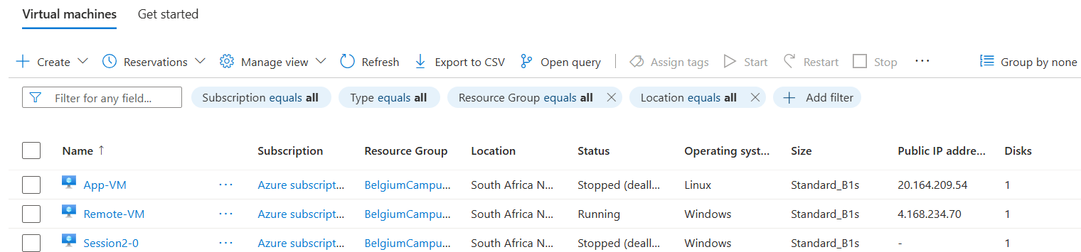
Compute Resources
VM | Purpose | Status
Remote-VM | Remote desktop access | Running
Session2-0 | AVD session host | Running

Slide 14
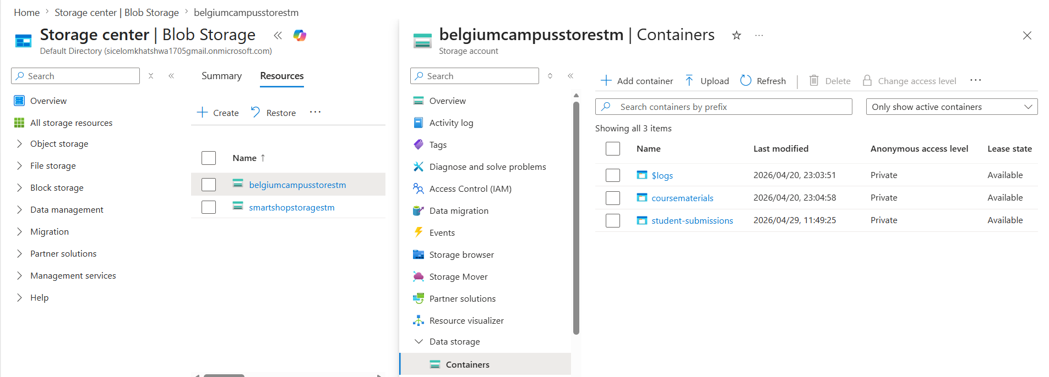
Storage and Collaboration
Storage Account: belgiumcampusstorestm
Blob containers for course materials and submissions
File share for student collaboration (group projects)
All containers have private access level

Slide 15
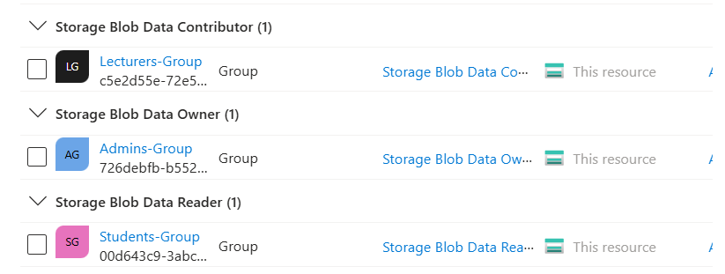
Security and Access Control
Microsoft Entra ID for authentication
Three security groups:
Students-Group (read-only access)
Lecturers-Group (write access)
Administrators (full control)
Principle of least privilege enforced

Slide 16
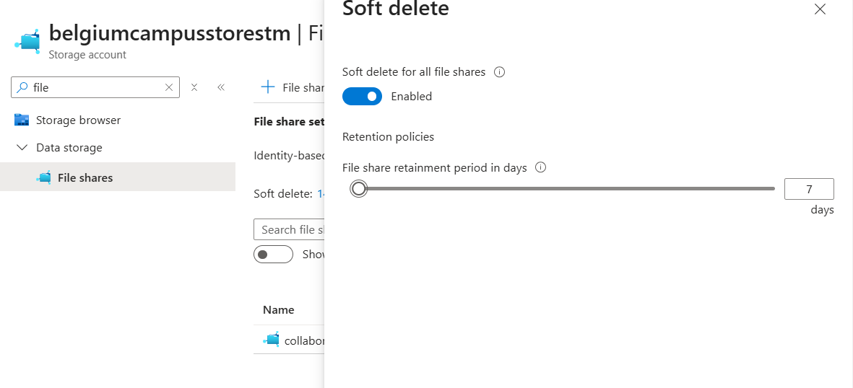
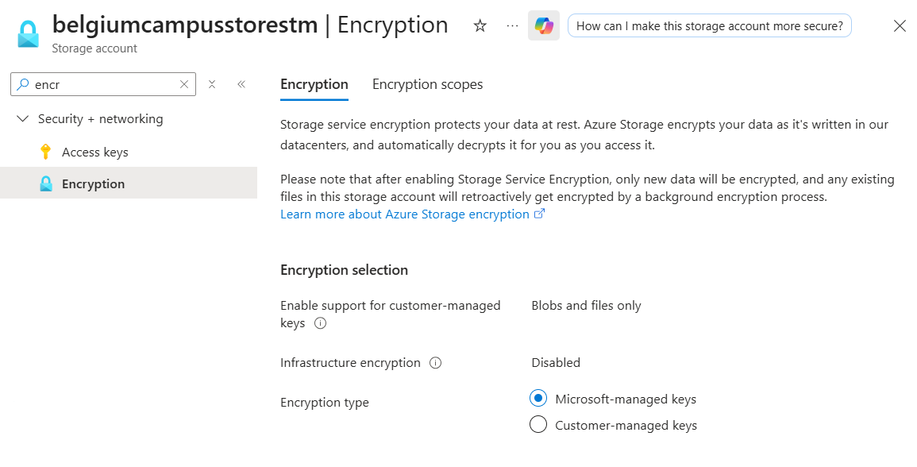
Data Protection
Blob versioning enabled
Soft delete (7-day retention)
Encryption at rest (Microsoft-managed keys)
Automated backups via versioning

Slide 17
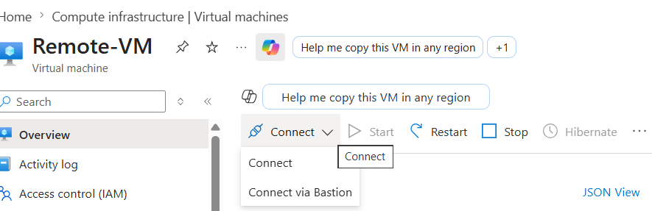
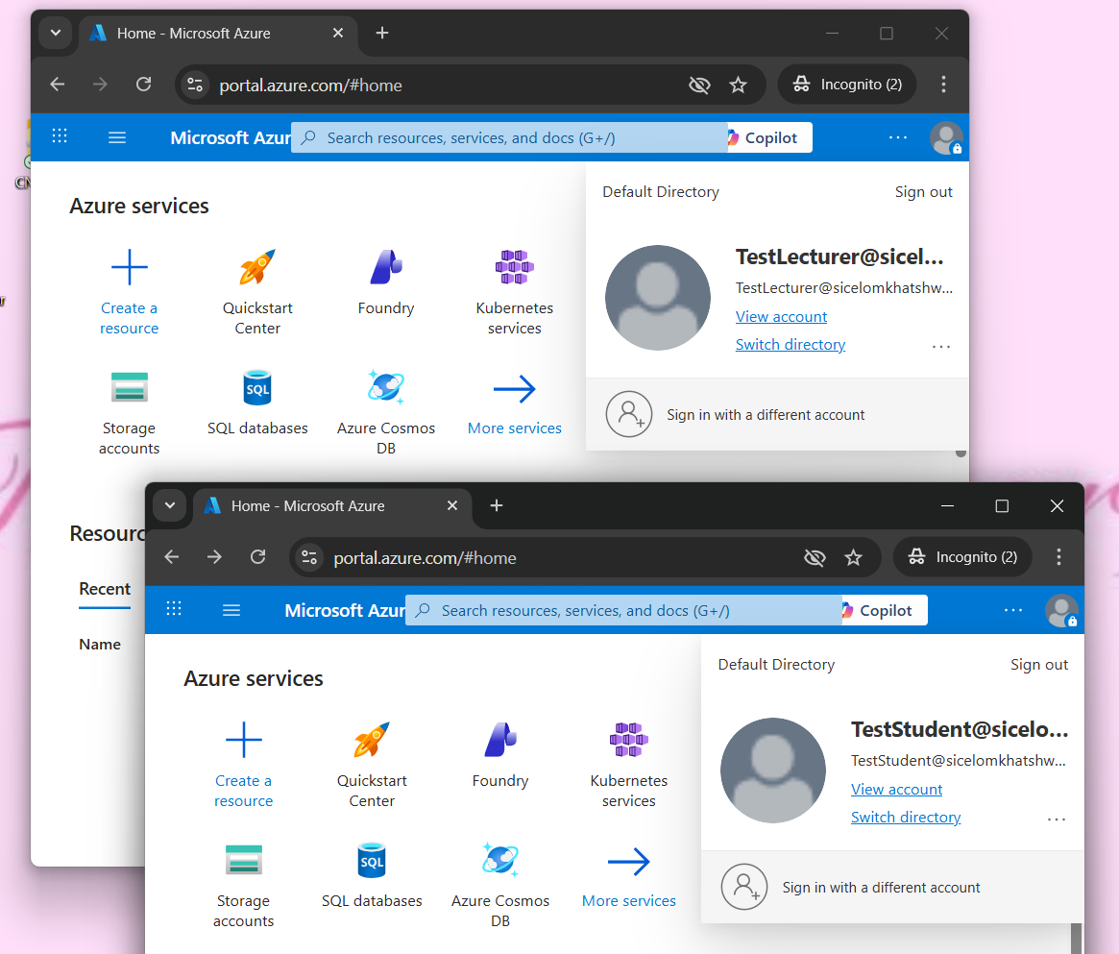
Remote Access
Azure Bastion for secure RDP connections
Azure Virtual Desktop (AVD) host pool
Students and lecturers can access Windows desktop from anywhere
No public IP exposure for management

Slide 18
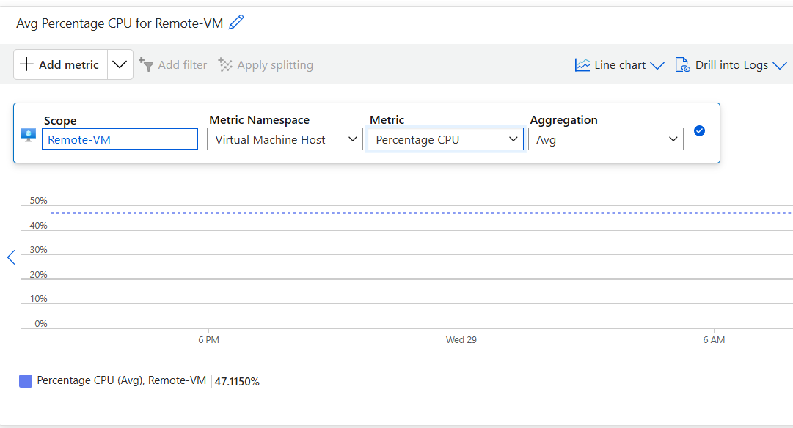
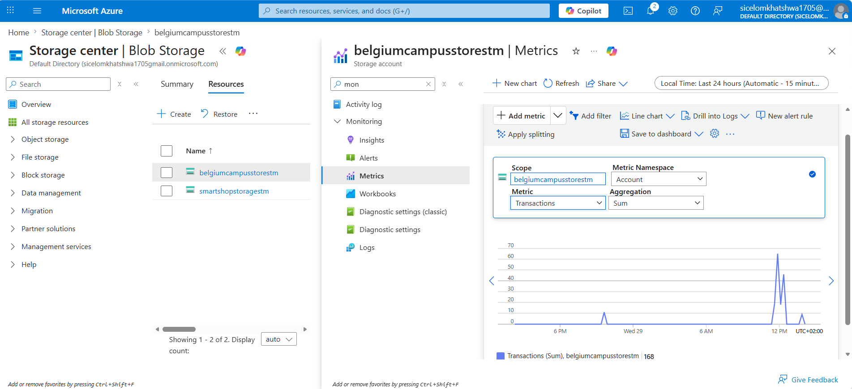
Testing & Monitoring
All components tested and operational
Azure Monitor tracks CPU usage and transactions
VM CPU usage: < 50% average
Storage transactions: Successful with no errors

Slide 19
Remote Access
Azure Bastion for secure RDP connections
Azure Virtual Desktop (AVD) host pool
Students and lecturers can access Windows desktop from anywhere
No public IP exposure for management

Slide 20
Lessons Learned
What we learned:
Cloud infrastructure requires careful planning
Networking and security are critical
RBAC enforces least privilege
Remote access solutions work reliably
Monitoring is essential for performance
Challenges faced:
AVD web client consent errors (resolved with direct RDP)
Bastion permission issues (proves security works)
Storage account naming conflicts (resolved with unique names)

Slide 21
LIVE DEMO

Slide 22
THANK YOU

